Slide 1
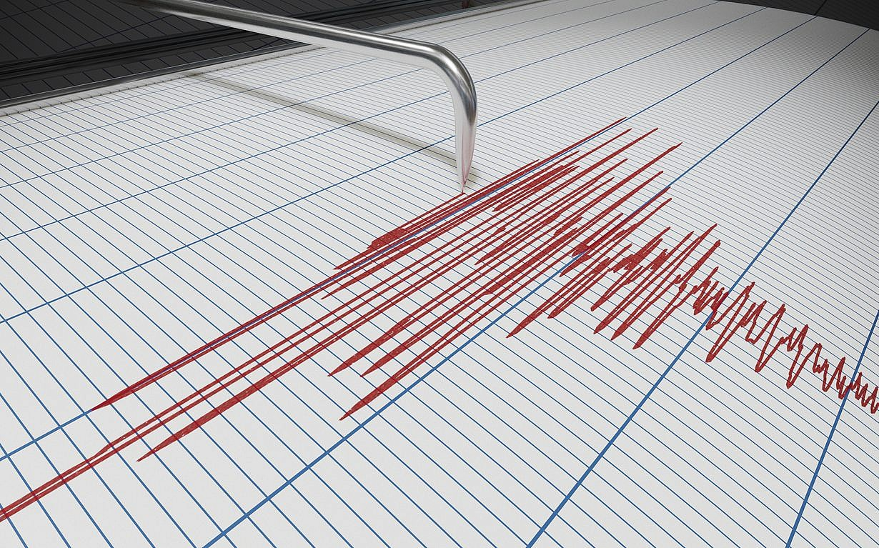
Michelle Kim, 05/04/23
Relation of major earthquakes and GDP rate

Slide 2
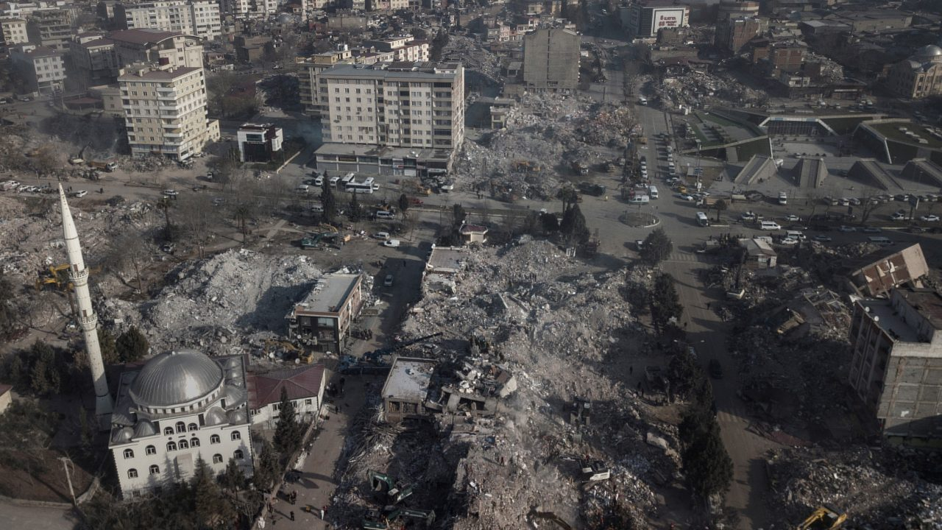
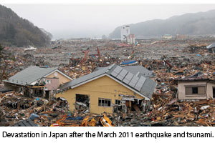
Introduction
In date of Feburary 6, 2023, 7.8 magnitude had hit southeast of Turkey bordering Syria causing 50,000 deaths and 8,476 deaths. Also suffering with 34billion dollars’ 4percent of Turkey’s economic
Due to Japan 2011 earthquake, Asian economic supply lines become much more conflicted which Japan takes up 15 percent value of suppling machinery equipment and electrical components.
Among lists of natural disasters, earthquake seems to likely effect within single country range.
It suggest earthquakes usually reduces 1.6%GDP rate due to : Loss of employment
Loss of exports
Increase of crime rates
Opportunity cost cause of recoveries of infrastructures.
Purpose: Create database and visualization within selected earthquake and countries range from 7.0 through 9.0 and compare to its GDP rate
CONTENTS
컨텐츠에 대한 내용을 적어요
Enjoy your stylish business and campus life with BIZCAM
49.7%
CONTENT
58.9%
CONTENT

Slide 3
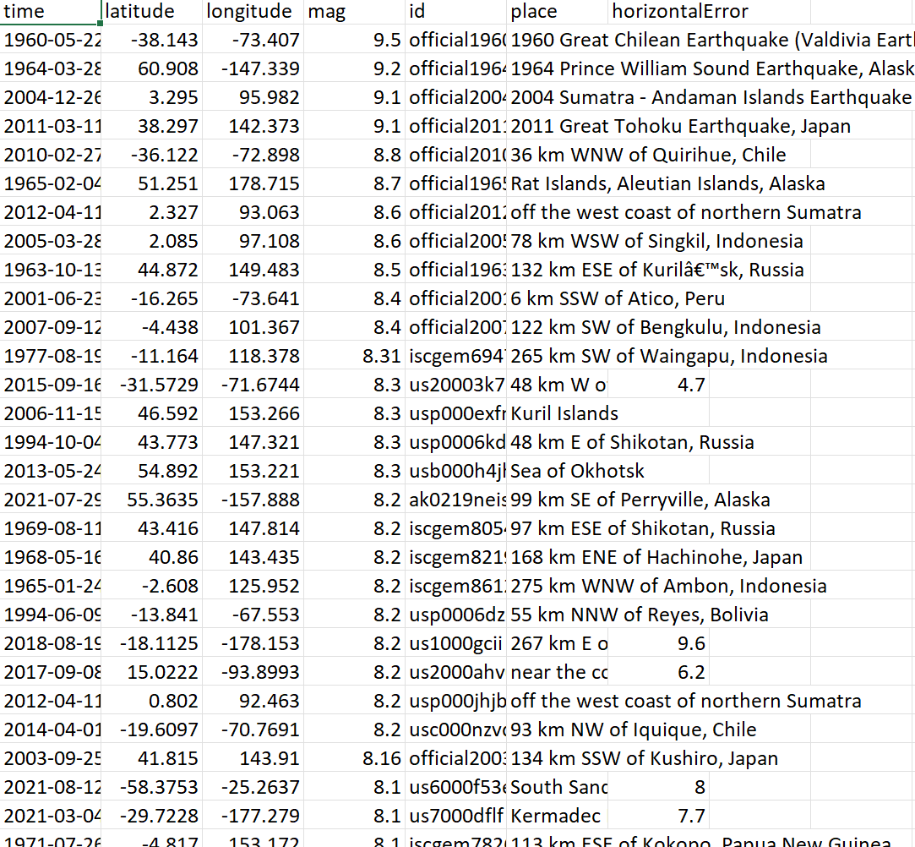
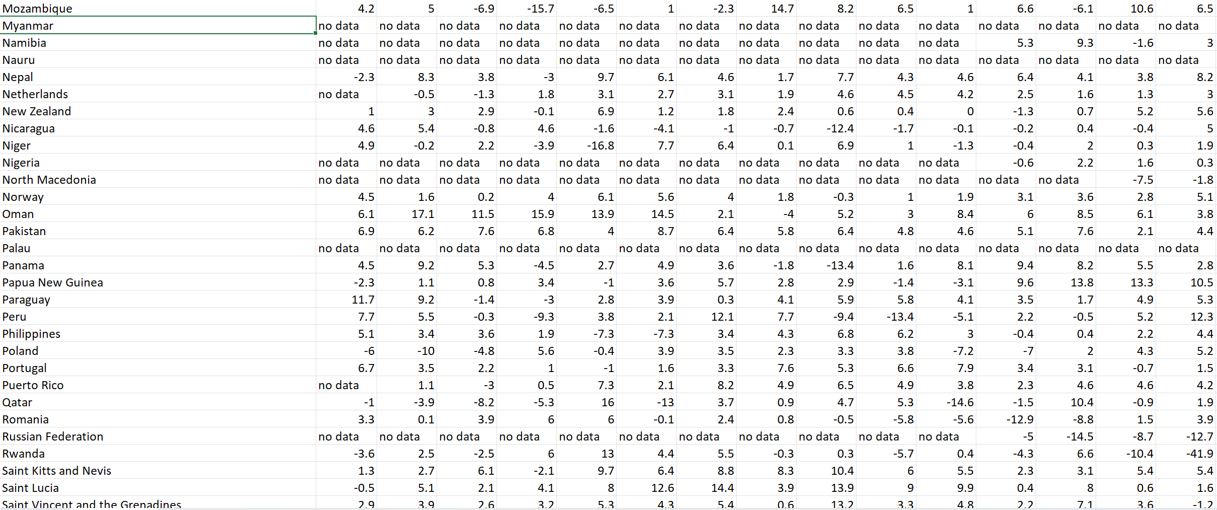


Data Collection
USGS
Variables with earthquake ID, time, latitude, longitude, magnitude, place(country)
+
+
+
International Monetary Fund
Collected annual GDP data from year 1980 through 2022 and also determines its countries economic categories.

Slide 4
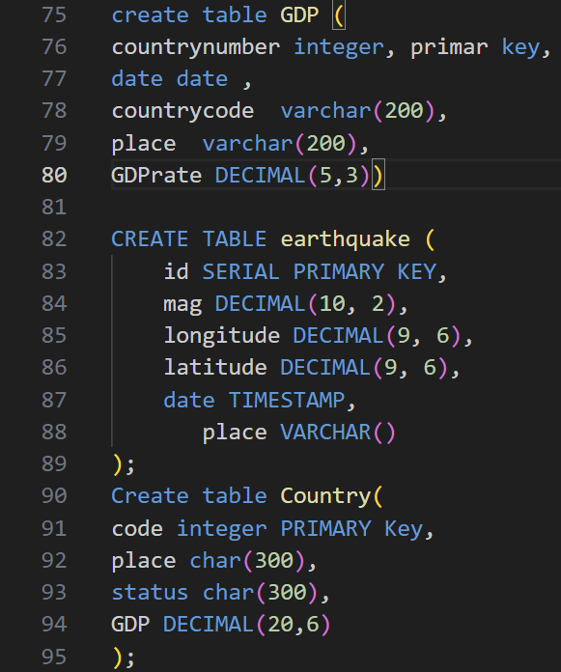
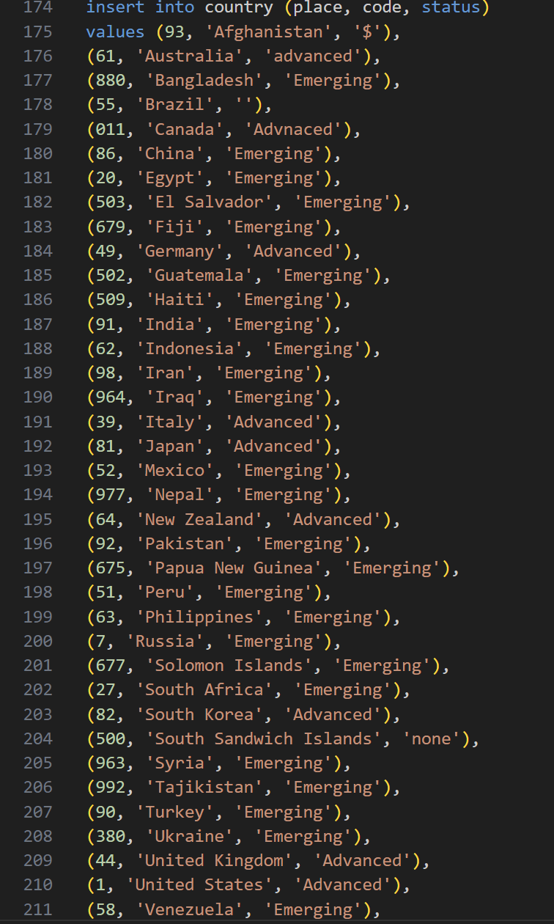
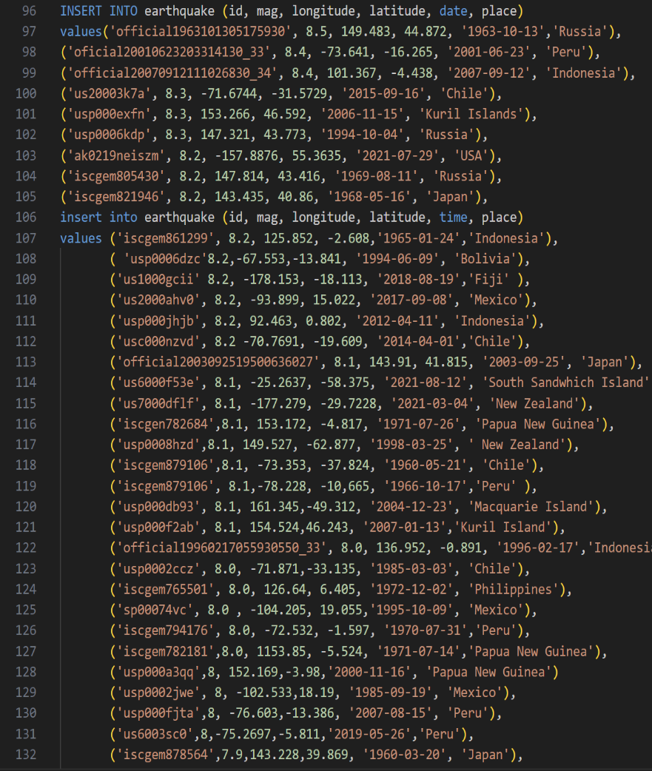
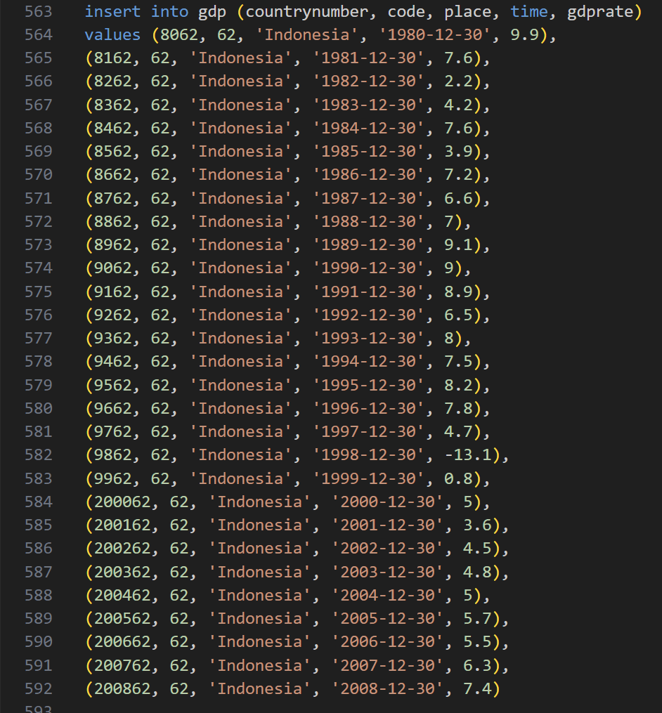
DATA CLEANING and creating TABLES
Notes:
dgrdgrgrgdrg

Slide 5
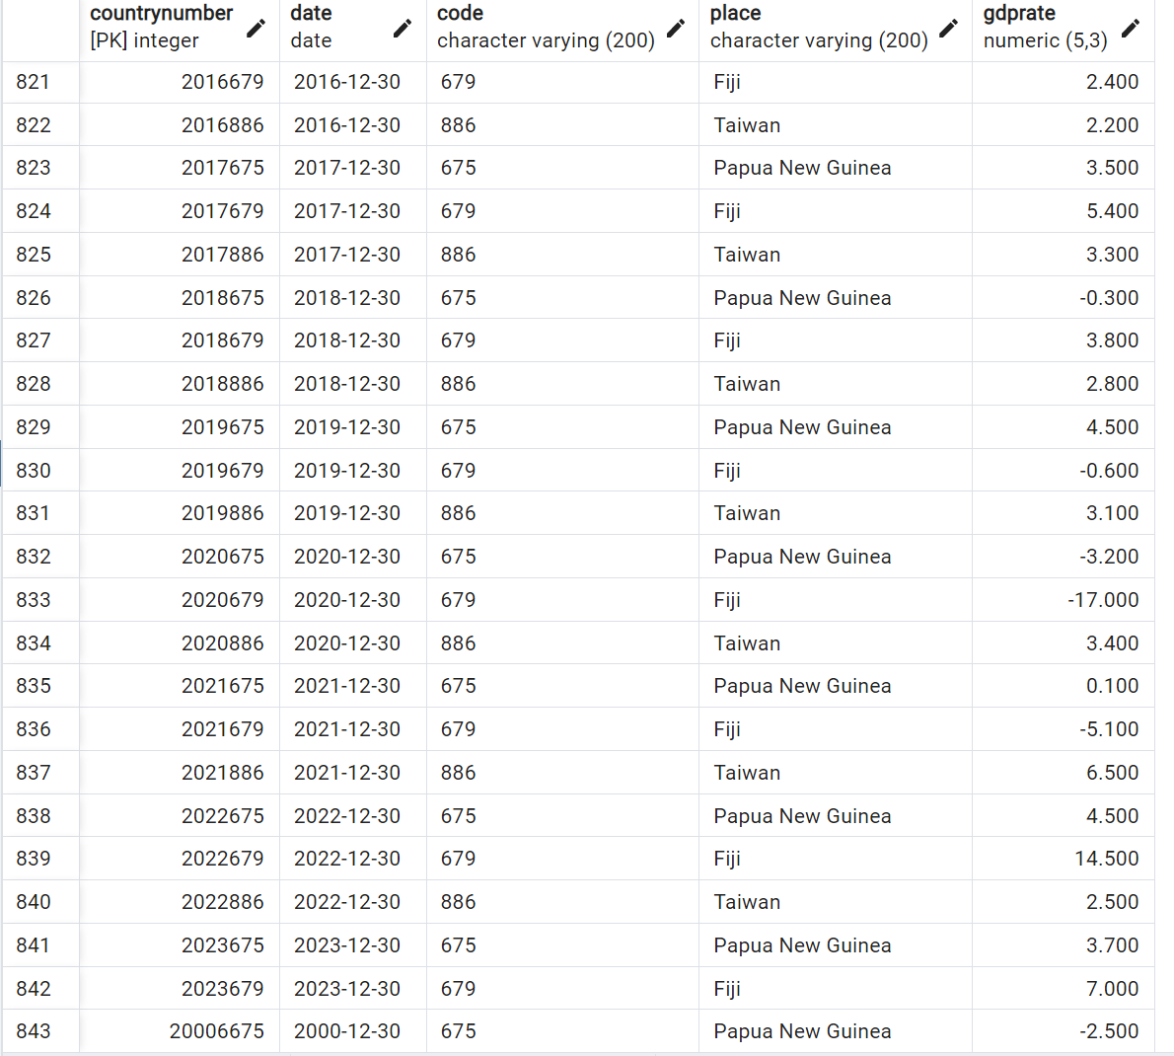
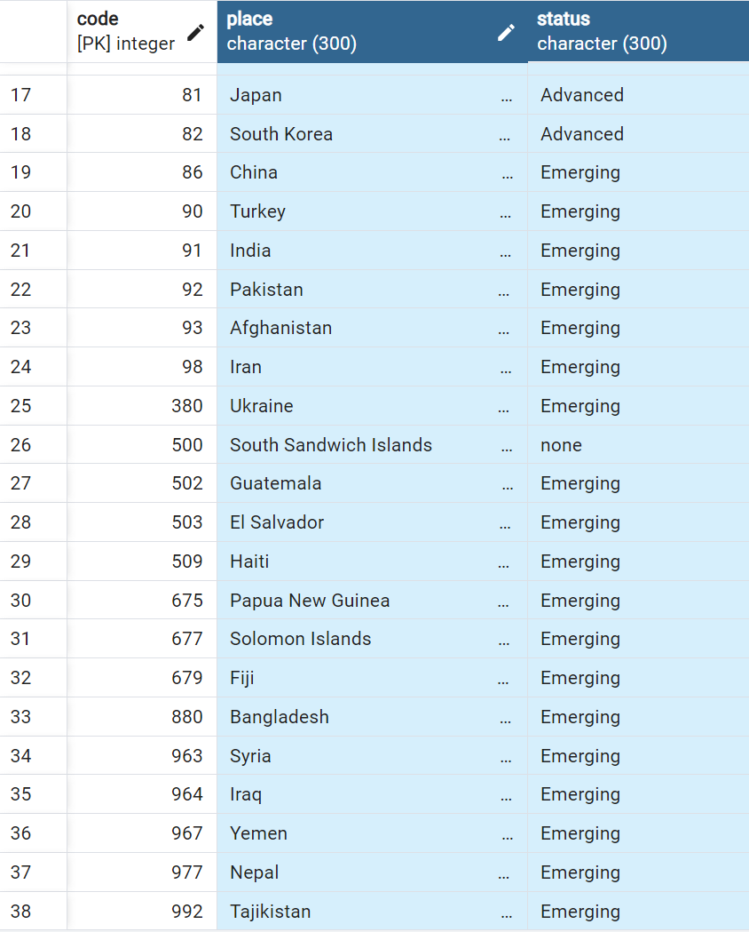
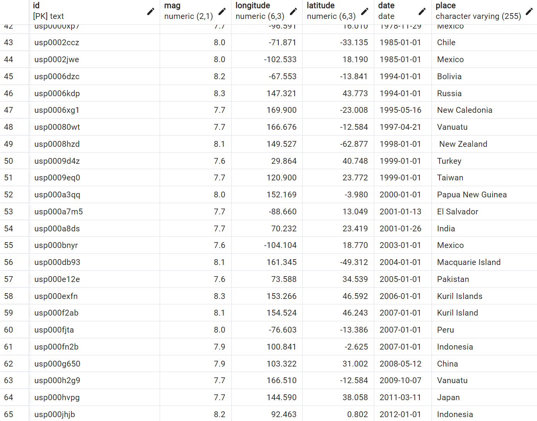
DATA CLEANING/ TABLES
Country table
Earthquake table
GDP table

Slide 6
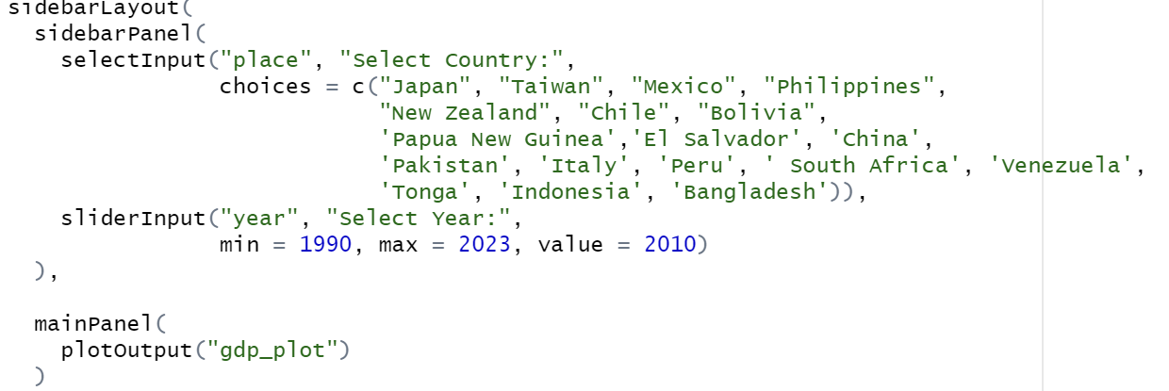
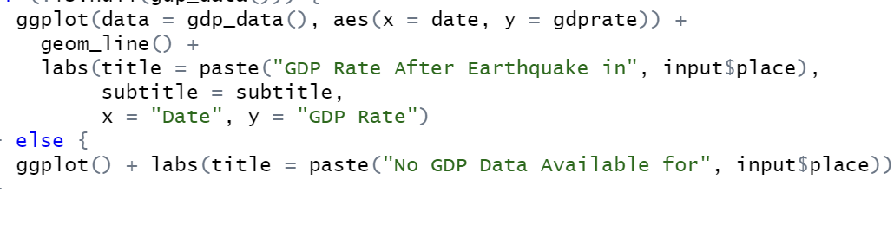
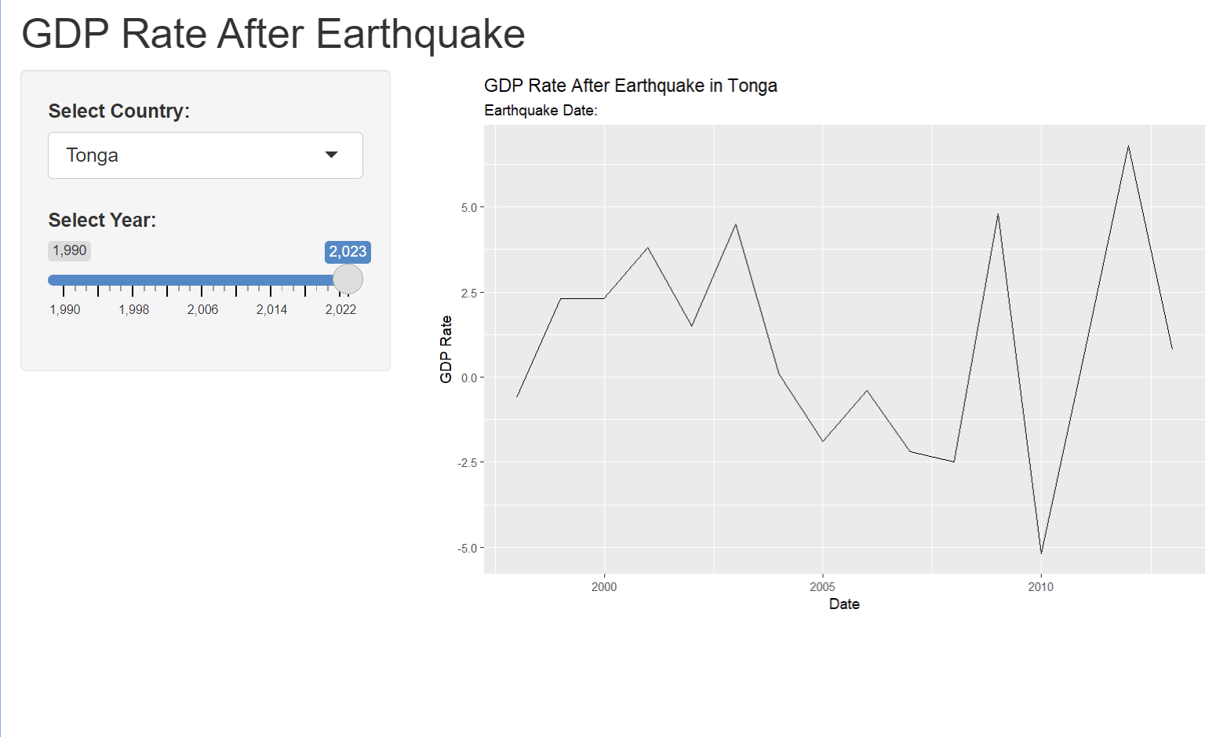
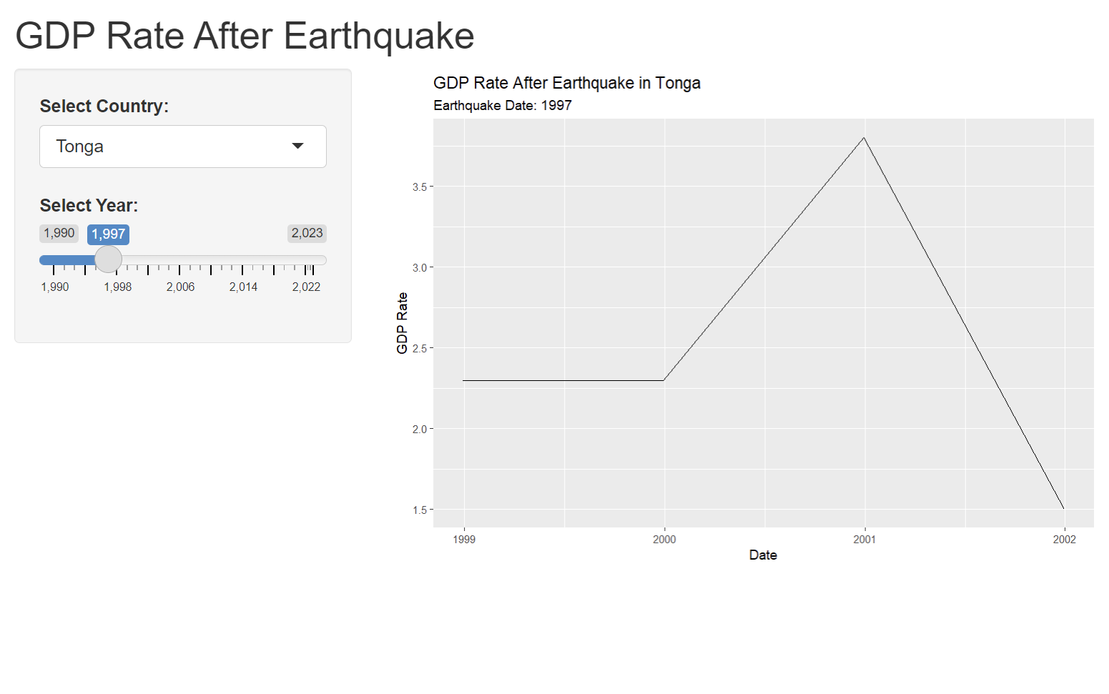
Analysis
CONTENTS
컨텐츠에 대한 내용을 적어요
Enjoy your stylish business and campus life with BIZCAM
CONTENTS
컨텐츠에 대한 내용을 적어요
Enjoy your stylish business and campus life with BIZCAM
CONTENT
49.7%
49.7%
CONTENT
58.9%
CONTENT
58.9%
CONTENT
Check

Slide 7
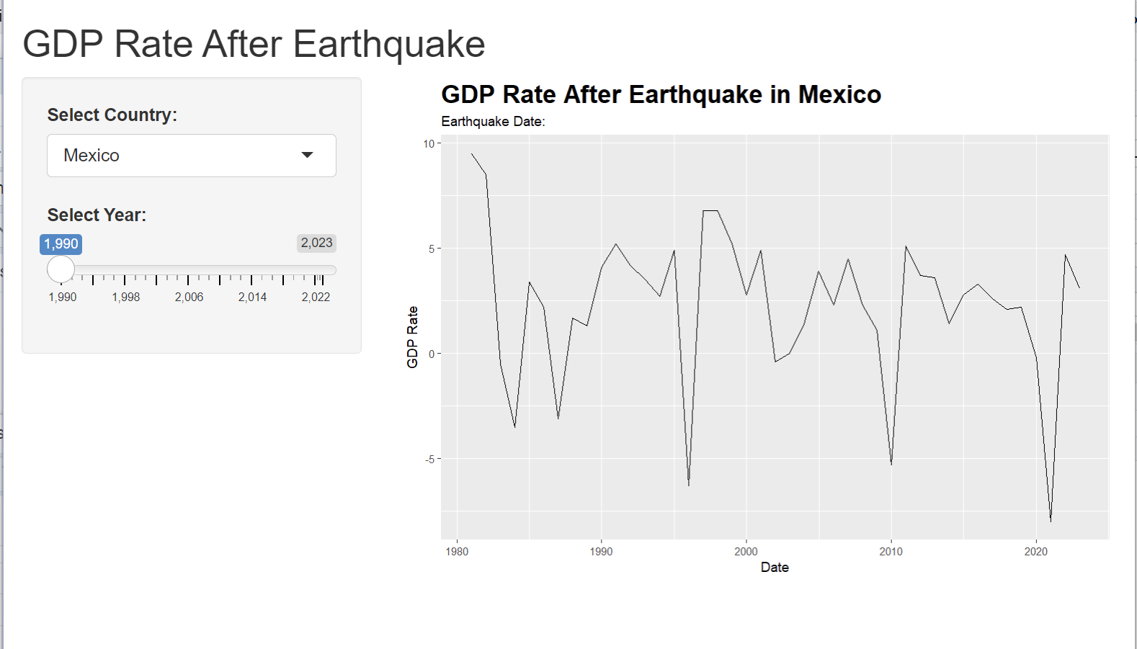
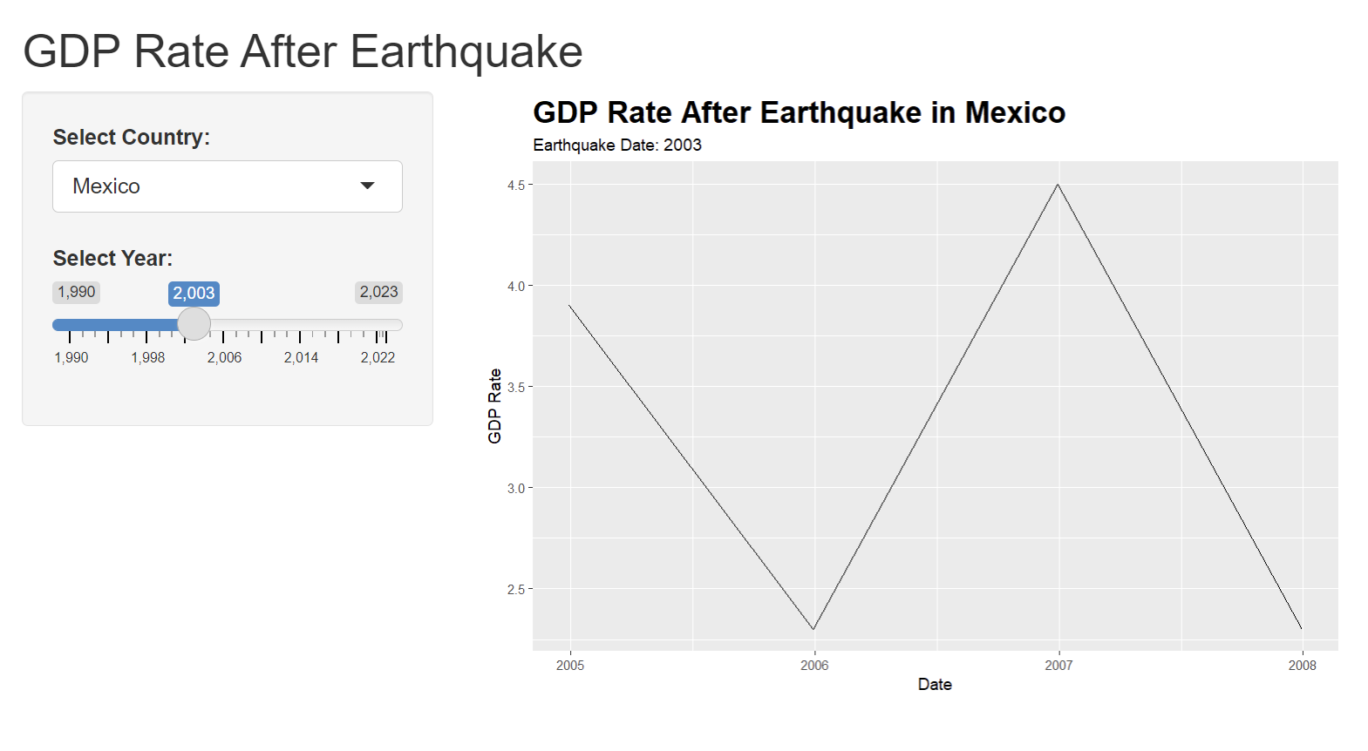
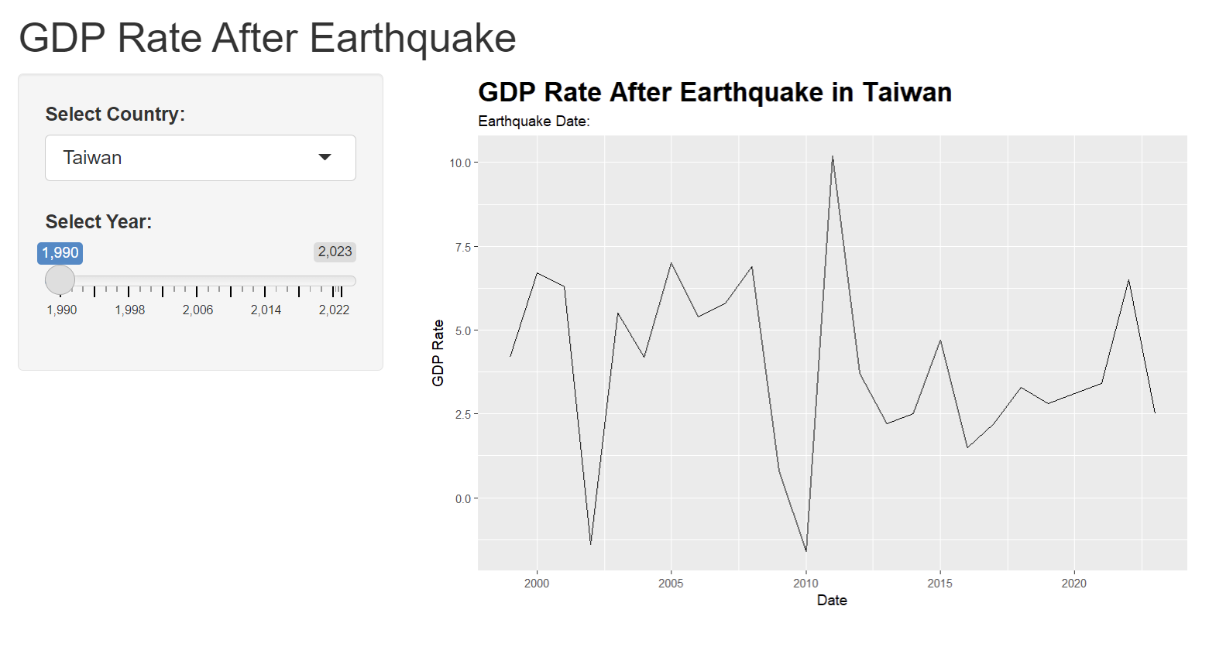
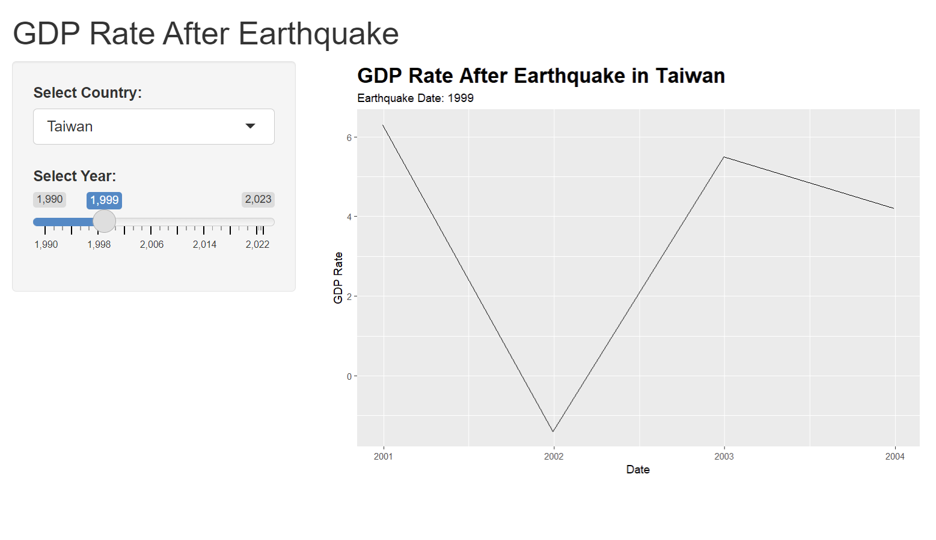
Analysis
CONTENTS
컨텐츠에 대한 내용을 적어요
Enjoy your stylish business and campus life with BIZCAM
CONTENTS
컨텐츠에 대한 내용을 적어요
Enjoy your stylish business and campus life with BIZCAM
CONTENT
49.7%
49.7%
CONTENT
58.9%
CONTENT
58.9%
CONTENT
Check

Slide 8
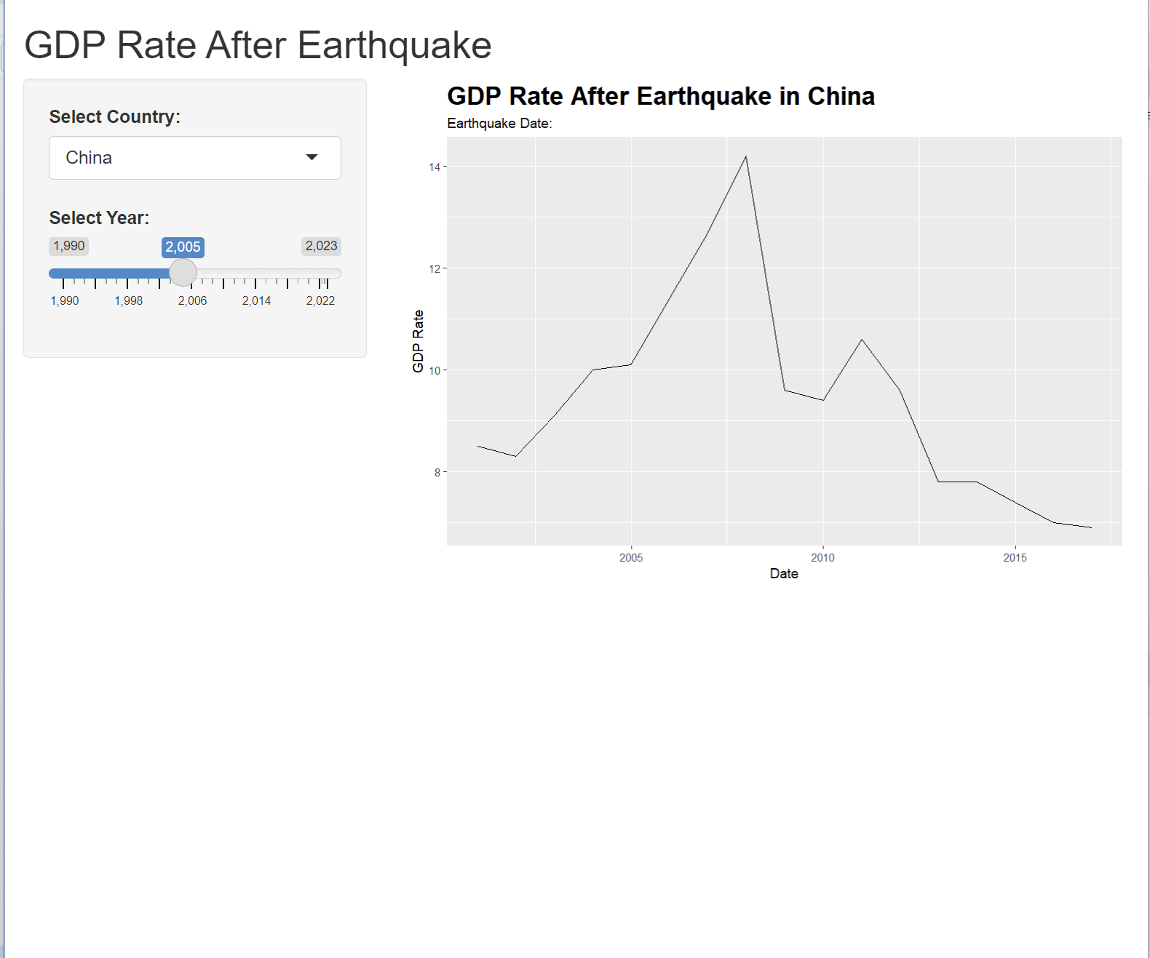
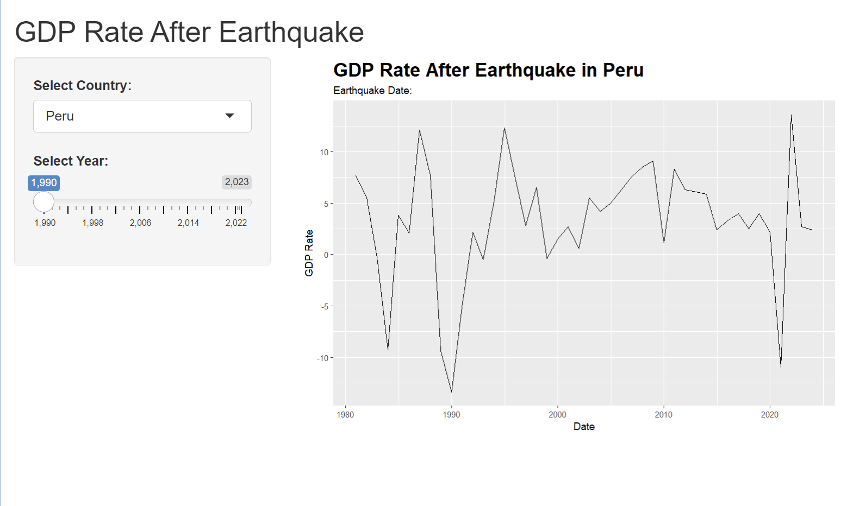

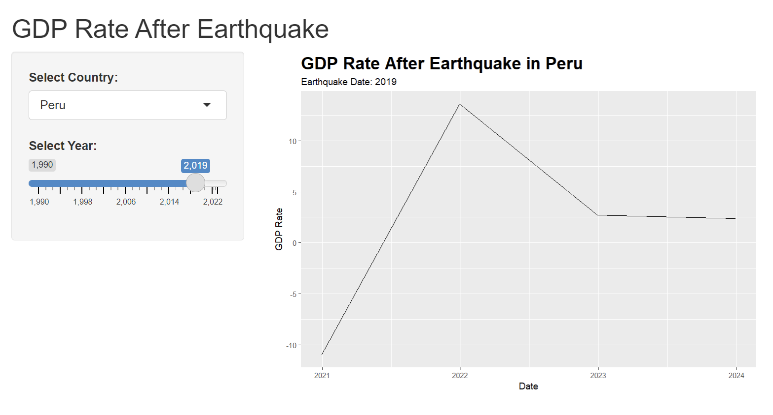
Analysis
CONTENTS
컨텐츠에 대한 내용을 적어요
Enjoy your stylish business and campus life with BIZCAM
CONTENTS
컨텐츠에 대한 내용을 적어요
Enjoy your stylish business and campus life with BIZCAM
CONTENT
49.7%
49.7%
CONTENT
58.9%
CONTENT
58.9%
CONTENT
Check
CONTENTS
컨텐츠에 대한 내용을 적어요
Enjoy your stylish business and campus life with BIZCAM
CONTENTS
컨텐츠에 대한 내용을 적어요
Enjoy your stylish business and campus life with BIZCAM

Slide 9
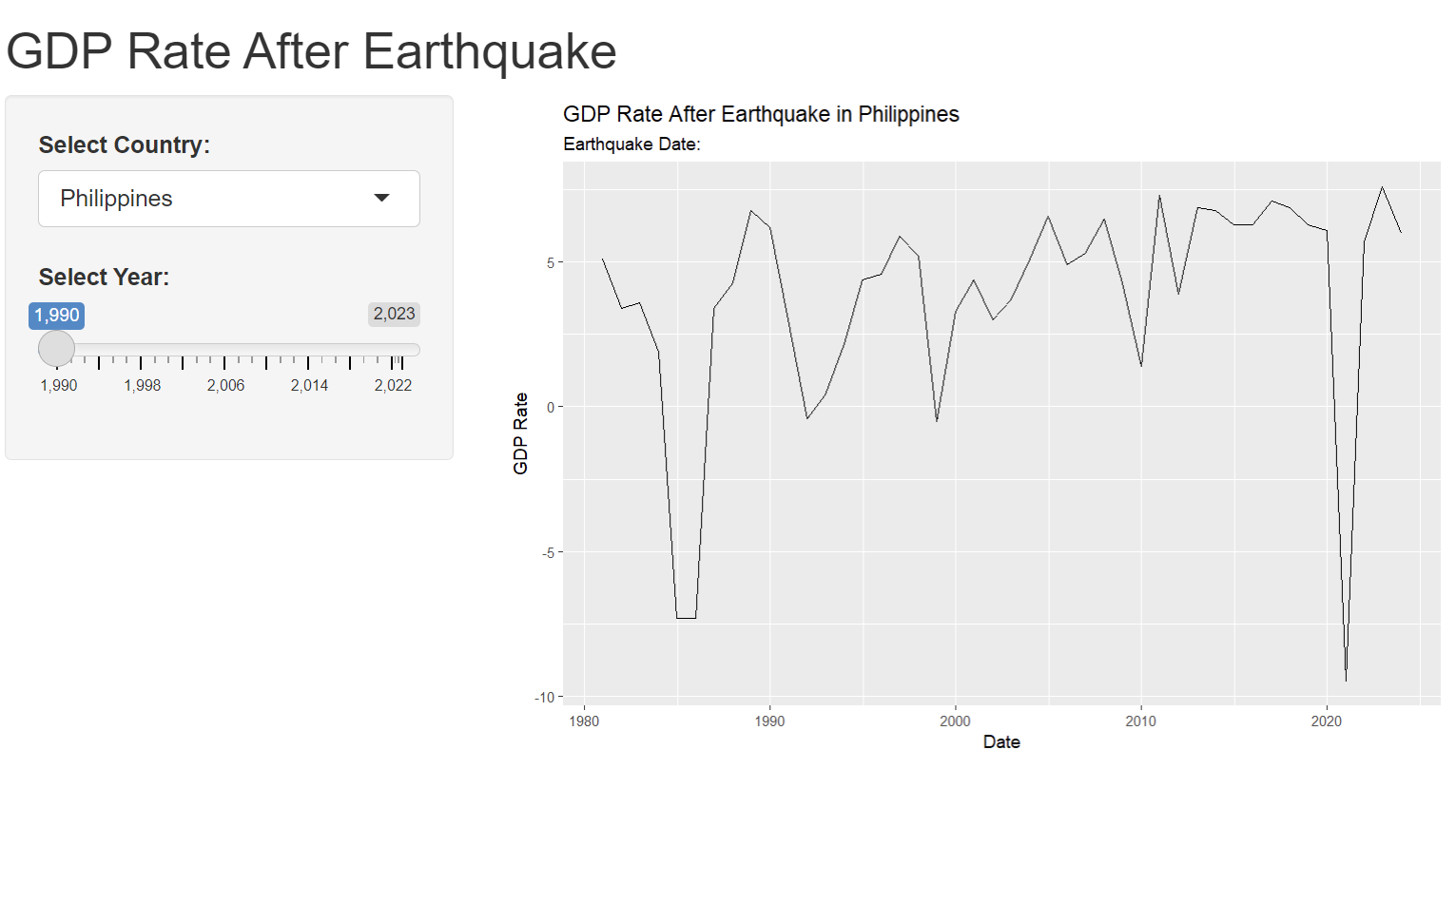
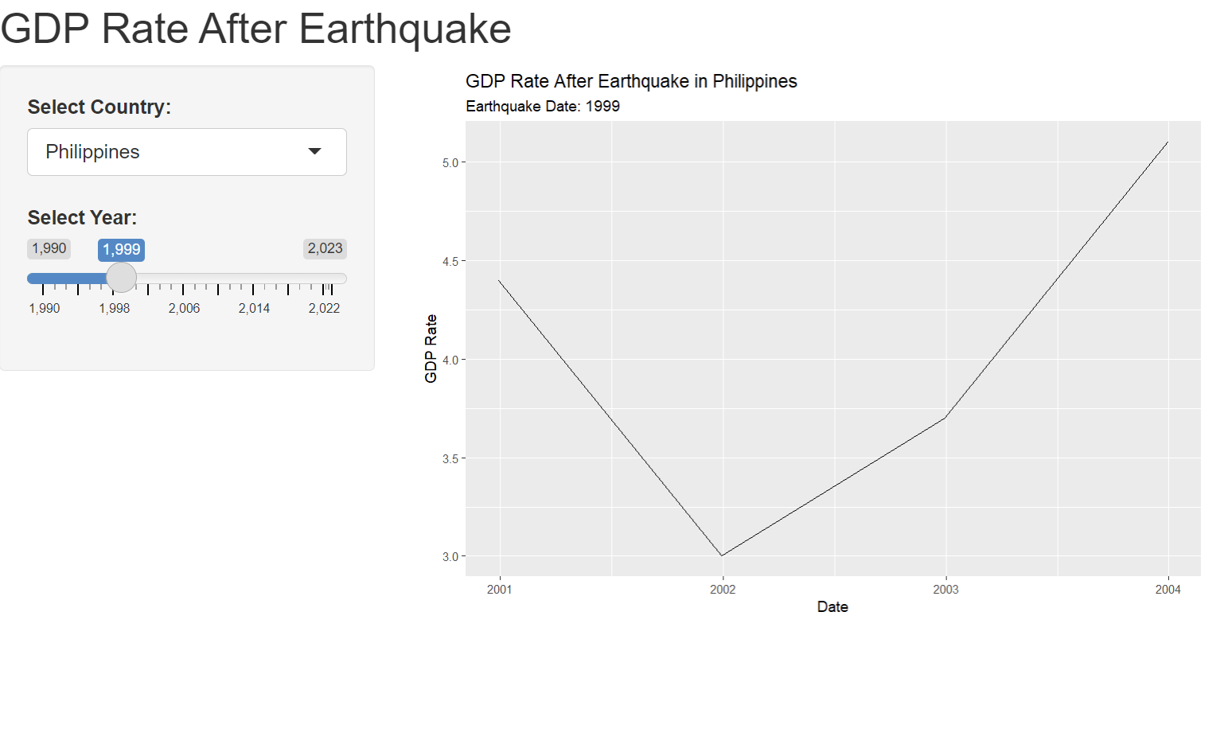
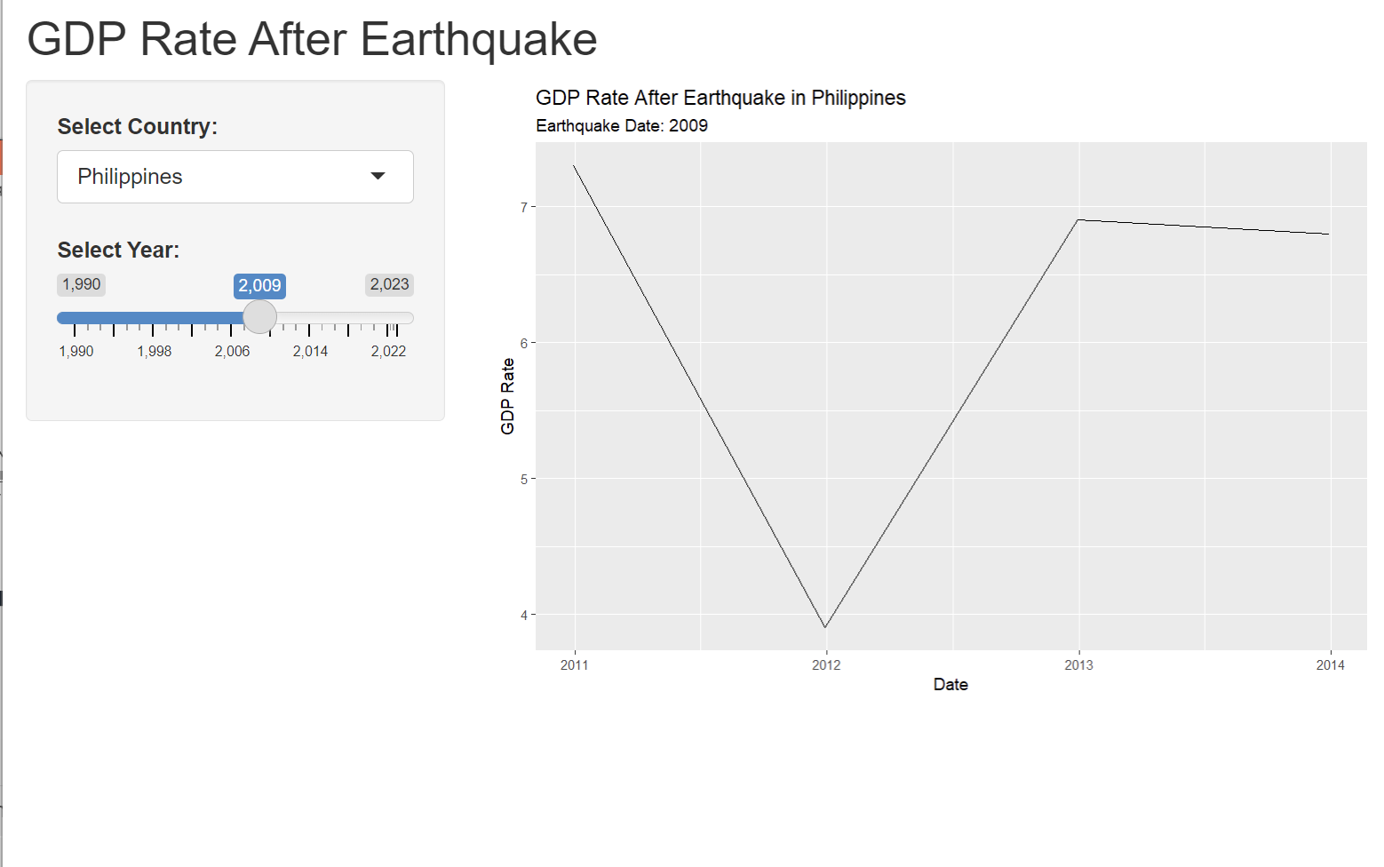
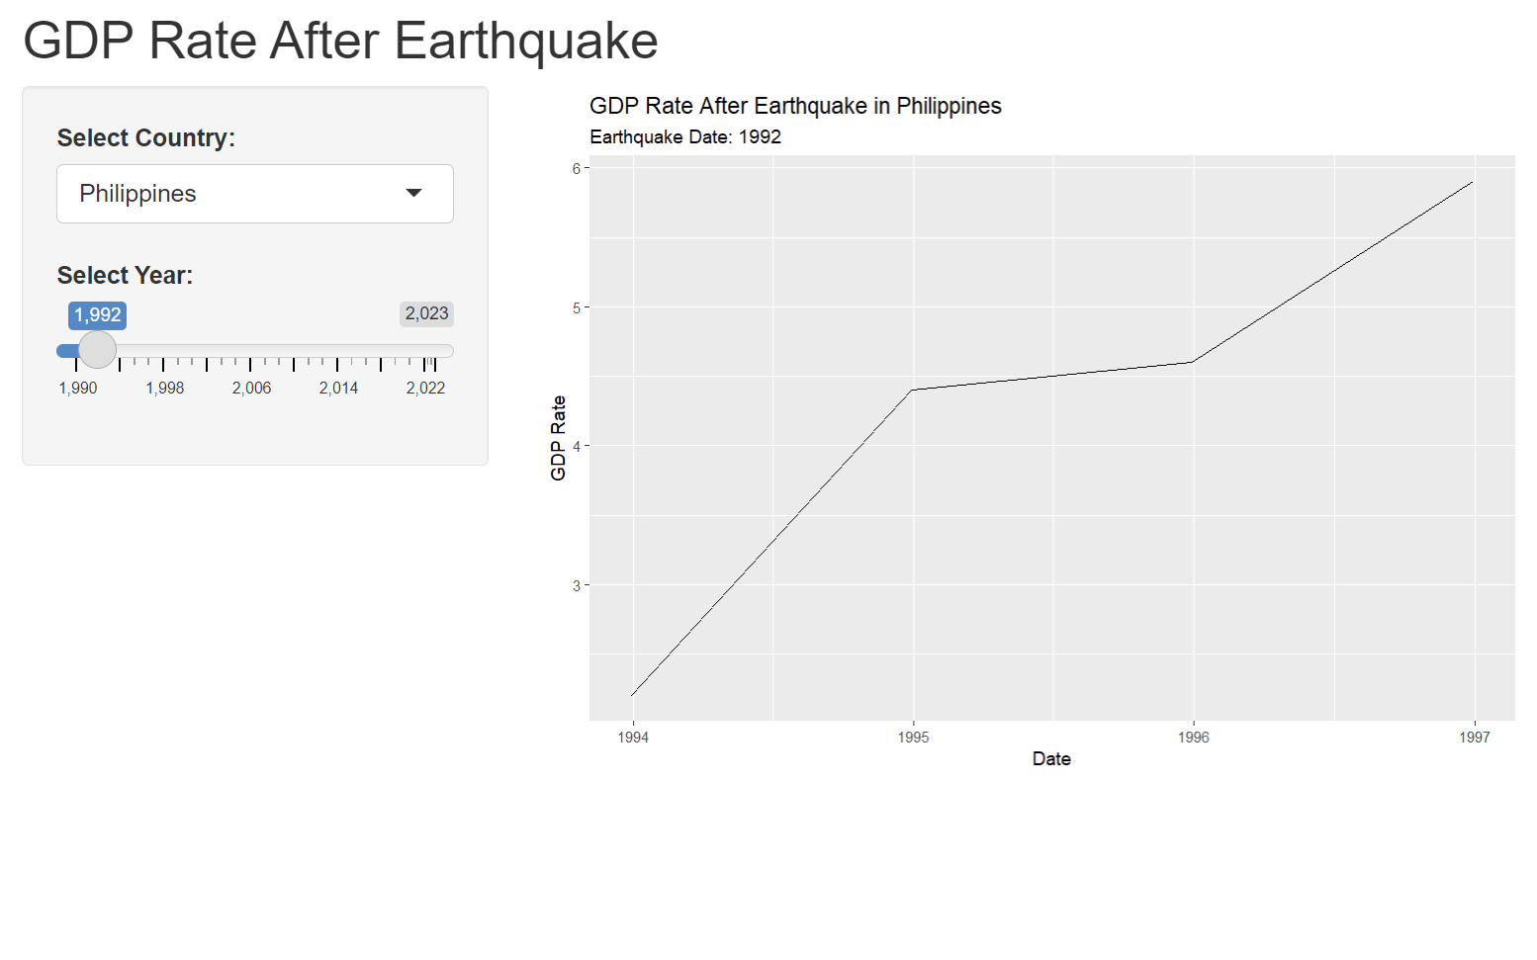
Analysis
CONTENTS
컨텐츠에 대한 내용을 적어요
Enjoy your stylish business and campus life with BIZCAM
CONTENTS
컨텐츠에 대한 내용을 적어요
Enjoy your stylish business and campus life with BIZCAM
CONTENT
49.7%
49.7%
CONTENT
58.9%
CONTENT
58.9%
CONTENT
Check
CONTENTS
컨텐츠에 대한 내용을 적어요
Enjoy your stylish business and campus life with BIZCAM
CONTENTS
컨텐츠에 대한 내용을 적어요
Enjoy your stylish business and campus life with BIZCAM

Slide 10
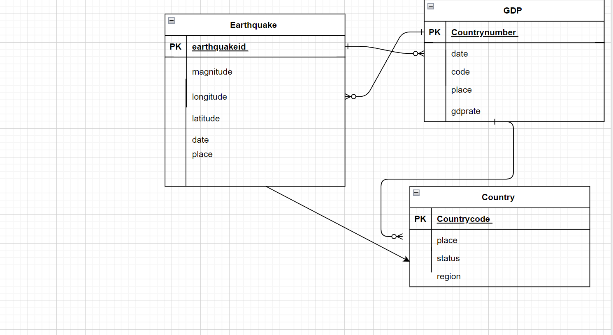
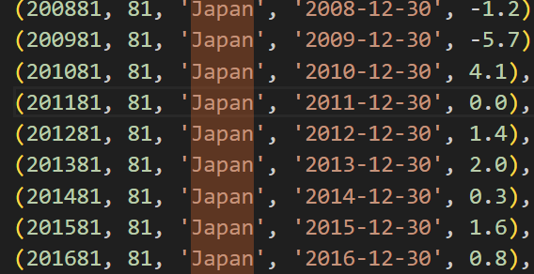
Conclusion/ Limitations
Limitations:
Quarterly GDP datas for better visualizations and changes. (For example, Japan 2011 earthquake had hit it has decreased -3.4% in GDP quarterly, but looking at annual GDP, there aren’t much change)
Create more tables : there are more factors that fluctuate GDP
Other natural disasters aftermath of earthquakes

